Slide 1
Docker network

Slide 2
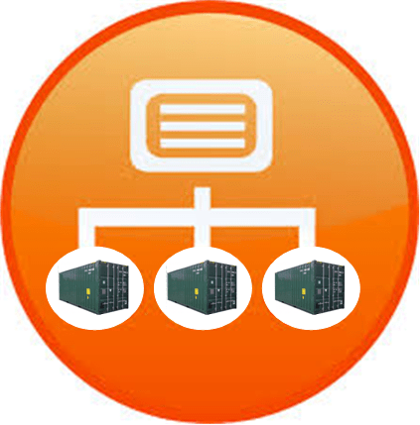
Docker Network Driver
There are 3 types of network driver
  Bridge (default or docker 0)
  Host
  None
Bridge
  Container get attached
  Pvt internal network created by docker
  IP address in the range of 172.17 series
  2 types of bridge
    Default
    Custom

Slide 3
Overlay and ingress network
Overlay
  Create an internal private network that spans across all the nodes
  Attach containers or services to this network
Ingress Network
  When executing Docker Swarm, automatically created Ingress Network
  It has build in a load balancer that redirect the traffic

Slide 4
Docker network behind scene
Docker created docker0
it is called bridge network
As soon as you create a container
  Create a bridge network which connect for us
  Container create a Vethx
  Vethx communicate to Docker0
  Docker0 give us to access and communicate container

Slide 5
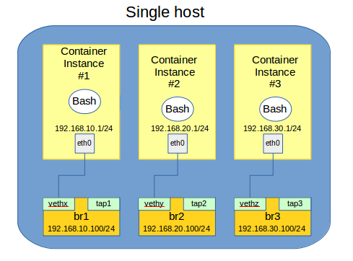
Docker0 interface is a Virtual Ethernet bridge.
Connect container and local host
Container has to communicate within a host
When Docker create a container, it create a pair of peer interface.
Eth0
Vethx
Vethx : One end plugged into Bridge and other end plugged into Container
Every Container is having Vertx

Slide 6
Host network
Isolation between docker container and host
Docker does not create any network
It will use host network
docker run -it --net=host --name myubuntu ubuntu:14.04
docker network ls
docker network inspect host

Slide 7
None network
It won’t create any network

